Slide 1
Cauchy’s
Mean Value Theorem

Slide 2


















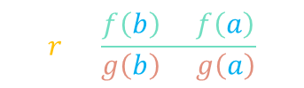
continuous
$$∈[a,b]$$
$$c$$
$$∈\left(a,b\right)$$
“no jumps”
“with end-points”
$\left[f\left(b\right)−f\left(a\right)\right]g’\left(c\right)=$ $\left[g\left(b\right)−g\left(a\right)\right]f’\left(c\right)$
$$h\left(b\right)=h\left(a\right)$$
differentiable
$$∈\left(a,b\right)$$
$$f\left(b\right)−rg\left(b\right)=f\left(a\right)−rg\left(a\right)$$
“no sharp turns”
“without end-points”
$$r=\frac{f\left(b\right)−f\left(a\right)}{g\left(b\right)−g\left(a\right)}$$
$$h\left(t\right)=f\left(t\right)−rg\left(t\right)$$
Rolle’s Theorem
$f(t)$
$$h\left(b\right)=h\left(a\right)$$
$$c$$
$$∈\left(a,b\right)$$
$g(t)$
$$h′\left(c\right)=0$$
$$f^{′}\left(c\right)−rg^{′}\left(c\right)=0$$
$$f^{′}\left(c\right)−\frac{f\left(b\right)−f\left(a\right)}{g\left(b\right)−g\left(a\right)}g^{′}\left(c\right)=0$$
$$t$$
$$a$$
$$b$$

Slide 3

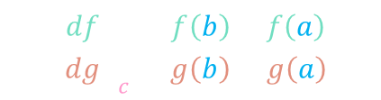

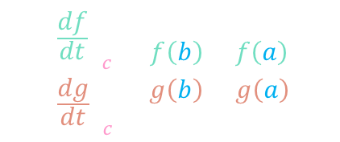



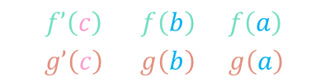






$$c$$
$$∈\left(a,b\right)$$
$\left[f\left(b\right)−f\left(a\right)\right]g’\left(c\right)=$ $\left[g\left(b\right)−g\left(a\right)\right]f’\left(c\right)$
$$\frac{{\left(\frac{df}{dt}\right)}_{c}}{{\left(\frac{dg}{dt}\right)}_{c}}=\frac{f\left(b\right)−f\left(a\right)}{g\left(b\right)−g\left(a\right)}$$
$$\frac{f’\left(c\right)}{g’\left(c\right)}=\frac{f\left(b\right)−f\left(a\right)}{g\left(b\right)−g\left(a\right)}$$
$$g$$
$${\left(\frac{df}{dg}\right)}_{c}=\frac{f\left(b\right)−f\left(a\right)}{g\left(b\right)−g\left(a\right)}$$
$$a$$
$$c_{2}$$
$$\left\langle f\left(a\right),g\left(a\right)\right\rangle$$
$$f$$
$$c_{3}$$
$$c_{1}$$
$$\left\langle f\left(b\right),g\left(b\right)\right\rangle$$
$$b$$

Slide 4

















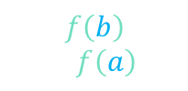



Remark
continuous
$$c$$
Cauchy’s
MVT
$$∈[a,b]$$
$$∈\left(a,b\right)$$
$$f \& g$$
differentiable
$$∈\left(a,b\right)$$
$\left[f\left(b\right)−f\left(a\right)\right]g’\left(c\right)=$ $\left[g\left(b\right)−g\left(a\right)\right]f’\left(c\right)$
$$g\left(t\right)$$
$$t$$
$\left[f\left(b\right)−f\left(a\right)\right]\left(1\right)=$ $\left[b−a\right]f’\left(c\right)$
continuous
Mean Value
Theorem
$$∈[a,b]$$
$$c$$
$$f^{′}\left(c\right)=\frac{f\left(b\right)−f\left(a\right)}{b−a}$$
$$f$$
$$∈\left(a,b\right)$$
differentiable
$$∈\left(a,b\right)$$
$$f\left(b\right)=f\left(a\right)$$
continuous
$$c$$
Rolle’s
Theorem
$$∈[a,b]$$
$$f\left(b\right)=f\left(a\right)$$
$$∈\left(a,b\right)$$
$$f$$
differentiable
$$∈\left(a,b\right)$$
$$f^{′}\left(c\right)=0$$

